Slide 1
Back to School
2020-2021
Mr. Driscoll - Grade 8 Science

Slide 2
Communication
Phone 609-561-3868 (school phone)
ddriscoll@mullicaschools.com

Slide 3
2020-2021 Course Syllabus
Course Outline

Slide 4
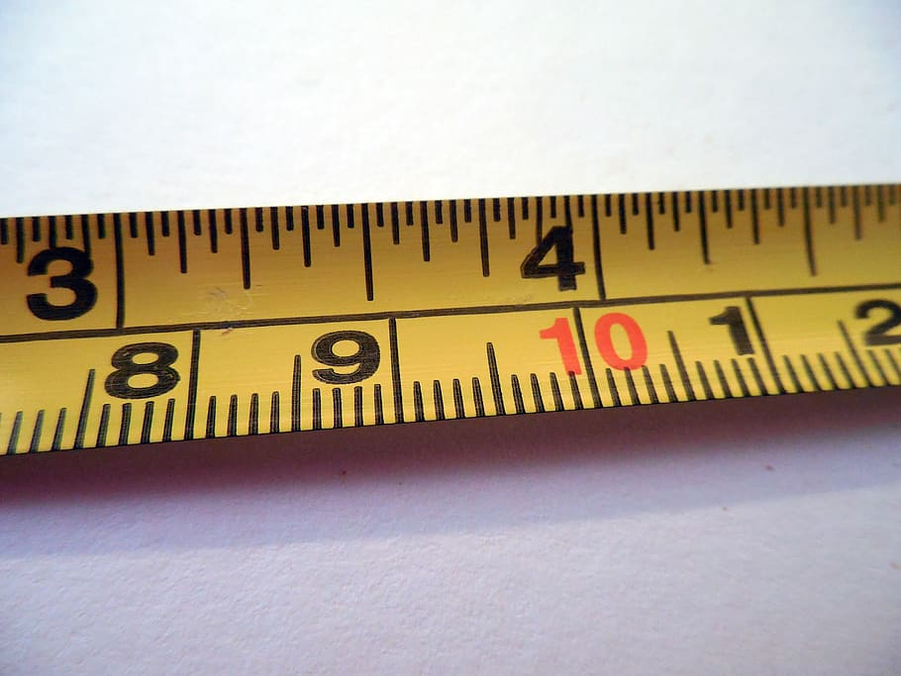
Sciences taught - STEMscopes
✪Measurement & SI
*Science Fair
✪Earth & Space
✪Life
✪Physical

Slide 5
Requirements
*Google Classroom – virtually paper free
*STEMscopes – online curriculum/NGSS - Self Discovery Learning
*Notebook/Binder – All students must take notes/properly file handouts - In person or digital - used for reference
*Pen or pencil – I never have them to give out; failure to bring one is a “0”
*Textbook? – Used periodically as a reference

Slide 6
Grading
PowerSchool – Access regularly
Percentages:
*Summative work - Tests, Labs/Group Projects – 75%
*Formative work - Quizzes, classwork & Homework – 25%

Slide 7
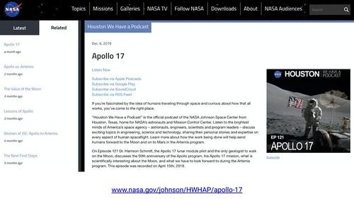
Extra Credit
*Many Opportunities (i.e. newspaper/other published science articles or you tube videos)
*Student will gain “bank” points to be used by end of given marking period
*Take Advantage!

Slide 8
Standardized Testing ????
*Students take mandatory NJSLA test with Science portion included in May
*Test includes questions in both multiple choice and open-ended varieties in Physical, Life, and Earth Sciences
*Class information prepares students for the test-no worries

Slide 9
Goals
*Benchmark improvement
*Students will be prepared for any NJSLA
*Self improvement
*High School Preparedness
I have met with GEHR teachers and know what is expected
Mullica students do very well at GEHR; positive feedback from teachers and past students

Slide 10
Need Help?
Email me/message me/Go Guardian
*Google Classroom
If absent: students are expected to check the website and keep up with the work

Slide 11
Google Classroom codes
Homeroom A - ryfdzar
Homeroom B - cp3umua
Science 8.1 - d4gx4ty
Science 8.2 - vphgeab
Science 8.3 - wdvubdf
Science 8.4 - 6m7s6np

